Slide 1
BRAINTEASER QA
Group 2 Hung Nguyen, Tawsik Jawad, Autri Ilesh Banerjee
Notes:
Intro

Slide 2
Problem Description - BRAINTEASER
BRAINTEASER's goal is to train a model that can accurately identify the correct answer from a list of options.
Involves puzzles that may require creative thinking, making it challenging for models to rely solely on surface level patterns or simple language understanding.
The questions can be challenging for the machines provided the semantic and contextual variety of way the question sentences are phrased despite being easy to humans.
BRAINTEASER consists of two separate subtasks: Sentence Puzzle and Word Puzzle, both of which require challenging commonsense "defaults" using different approaches.
Notes:
2-11 autri

Slide 3
Problem Description - SUbTASK
Sentence Puzzle: Create sentence-based brain teasers in which the objective is to read sentence snippets in ways which contradict commonsense expectations.
A man shaves everyday, yet keeps his beard long.
He is a barber.
He wants to maintain his appearance.
He wants his girlfriend to buy him a razor.
None of the above.
Word Puzzle: Create word-based brain teasers that challenge the default meanings of words, focusing on letter composition in the target question.
What part of London is in France?
The letter N.
The letter O.
The letter L.
None of the above.

Slide 4
Problem Description – Evaluation metric
Instance-based Accuracy: Instance-based accuracy takes into account each individual question (original or reconstruction). Instance-based accuracy is presented for the original problems, as well as semantic and contextual reconstructions.
Group-based Accuracy: Each question and its associated adversarial instances form a group, and a system will only receive a score of 1 when it correctly solves all questions in the group.

Slide 5
Dataset
Each question in has adversarial versions of the original data in two ways
Semantic Reconstruction (SR):
Original questions are rephrased semantically without changing answers or distractors.
Ensure that the model does not rely solely on surface-level cues or memorization and demonstrates a deeper semantic understanding of the problem.
Context Reconstruction (CR):
The original reasoning routes are preserved, but a new situational setting is presented.
Challenge the model to generalize its reasoning abilities to different contexts, ensuring that it is not overfitted to specific topics or scenarios and tests whether the model can decouple logical reasoning from context-specific details

Slide 6
Dataset - Examples
Original: A man shaves everyday, yet keeps his beard long.
He is a barber.
He wants to maintain his appearance.
He wants his girlfriend to buy him a razor.
None of the above.
Semantic Reconstruction: A man preserves a lengthy beard despite shaving every day.
He is a barber.
He wants to maintain his appearance.
He wants his girlfriend to buy him a razor.
None of the above.
Context Reconstruction: Tom attends class every day but doesn’t do any homework.
He is a teacher.
He is a lazy person.
His teacher will not let him fail.
None of the above.

Slide 7
Dataset - split
 | Number of questions
Dataset type | Train data | Validation data | Test Data
Sentence Puzzle | 405 | 48 | 54
Word Puzzle | 315 | 39 | 42

Slide 8
Similarity Score Evaluation - Description
Calculate the similarity score between a question and its semantic reconstruction form:
Lexical Similarity:
Tokenize each question and its semantic reconstruction form using a Bag of Words model
Evaluate the similarity each pair of questions through a tf-idf model
Semantic Similarity
Tokenize each question and its semantics recontruction form using MPnet model
Evaluate each pair of questions through the MPnet model to obtain a similarity score
Sort each pair of questions by descending similarity score
Evaluate the correlation between the semi-group accuracy for question and its semantic reconstruction form and the similarity score through Pearson correlation coefficient

Slide 9
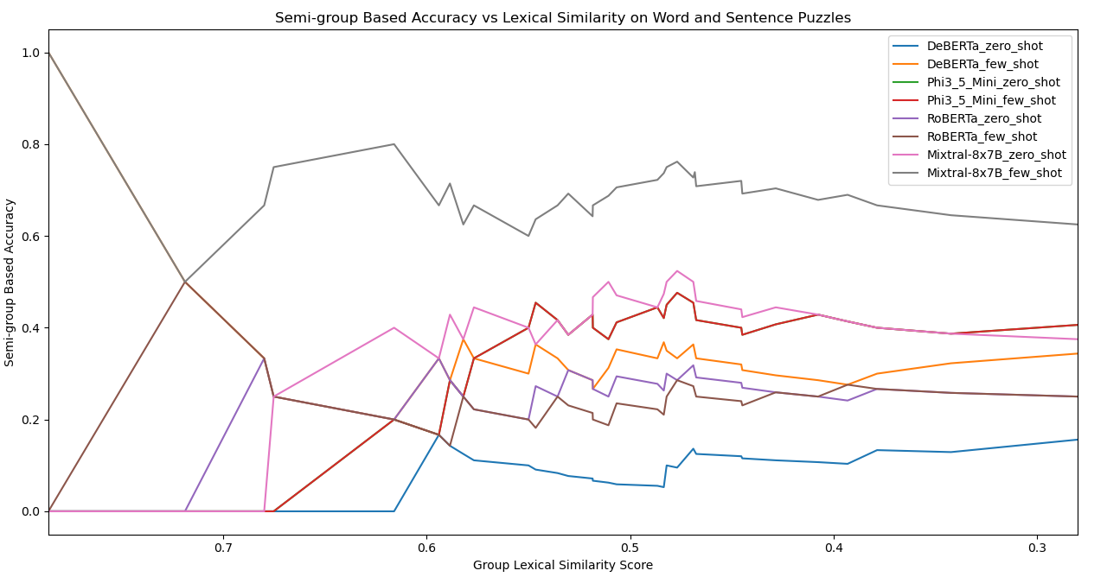
Similarity Score Evaluation - Graph

Slide 10
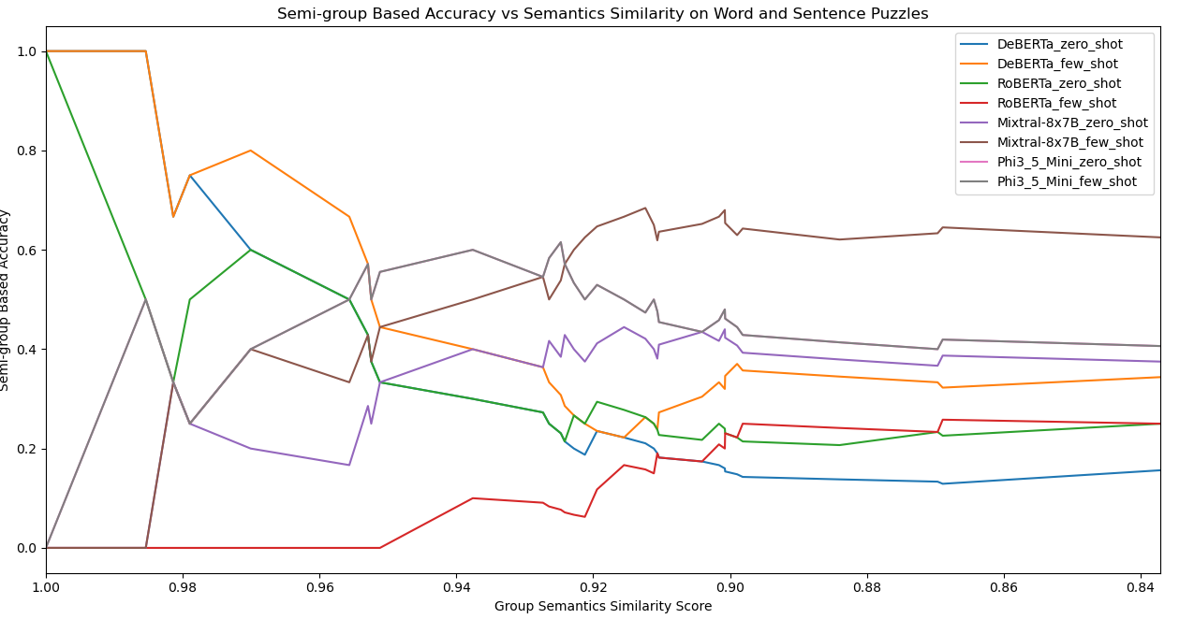
Similarity Score Evaluation - GrAPH

Slide 11
Similarity Score Evaluation - Correlation
Model | Semantic Similarity Coefficient | Lexical Similarity Coefficient
DeBERTa_zero_shot | 0.864559 | -0.49396
DeBERTa_few_shot | 0.773355 | -0.14108
Mixtral-8x7B_zero_shot | -0.71374 | -0.79943
Mixtral-8x7B_few_shot | -0.83946 | -0.79943
Phi3_5_Mini_zero_shot | -0.24504 | -0.56036
Phi3_5_Mini_few_shot | -0.24504 | -0.58749
RoBERTa_zero_shot | 0.744389 | -0.67722
RoBERTa_few_shot | -0.90573 | 0.472837
Total Average | -0.07084 | -0.40267
Semantic Similarity: Strong correlation observed between question similarity and semantic reconstruction for DeBERTa and RoBERTa, unlike other models.
Lexical Similarity: Positive correlation with group-based accuracy across several models.
Mixed results across other models prevent its inclusion in the final evaluation metrics.

Slide 12
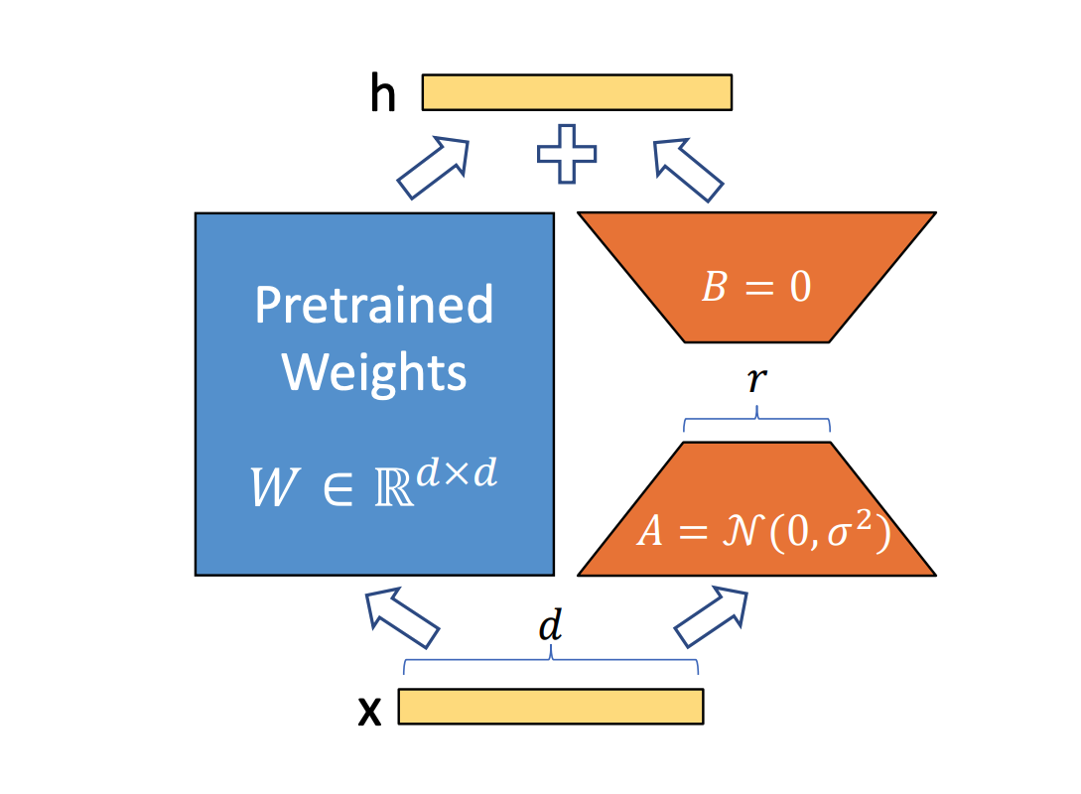
Hyperparameter tuning - LoRA
LoRA introduces two smaller, low-rank matrices, A and B, alongside the original weight matrices.
These smaller matrices contain the trainable parameters, reducing the number of parameters that need to be updated during training
LoRA significantly cuts down on the computational resources required for fine-tuning,
Notes:
12-21

Slide 13
Hyperparameter tuning – parameters
Batch size = 16
Epochs = 5
Rank = 4
LoRA alpha = 8
LoRA dropout = 0.1
Learning Rate = [0.1, 0.05, 0.01, 0.005, 0.001, 0.0005, 0.0001, 0.00001]
Weight Decay = [0.1, 0.05, 0.01, 0.005, 0.001, 0.0005, 0.0001, 0.00001]

Slide 14
Hyperparameter tuning – Overfitting & UNderfitting
When hyperparameter tuning, there is a chance that the model may underfit or overfit
Loss divergence = evaluation loss – training loss at last step
If loss divergence > 0, the model is overfitting
If loss divergence < 0, the model is underfitting
If loss divergence ≈ 0, the model is best fitting.

Slide 15
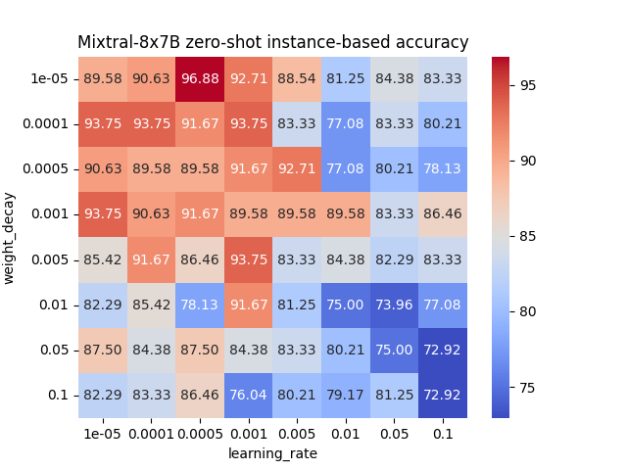
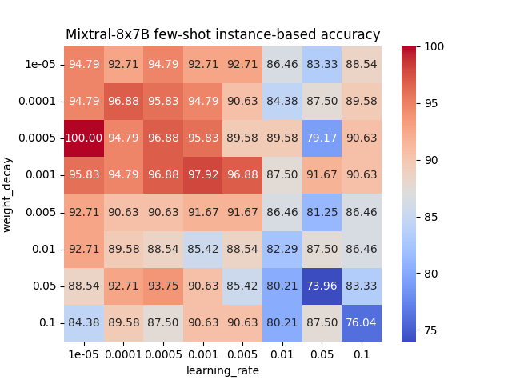
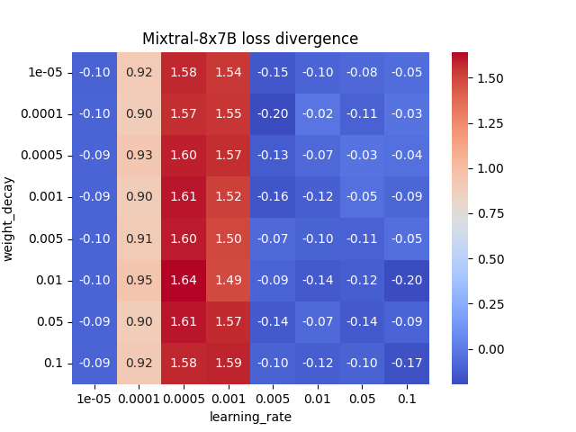
Hyperparameter tuning Results - Mixtral-8x7B-v0.1 instance-based

Slide 16
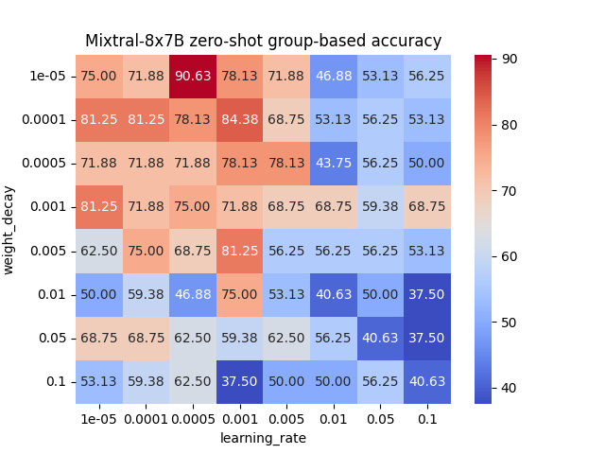
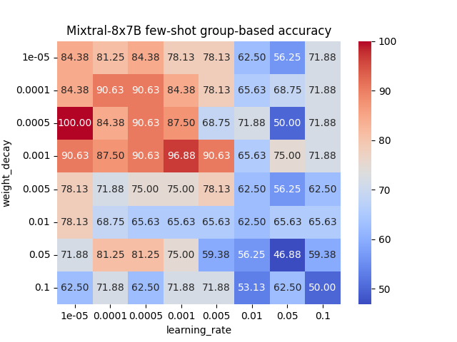
Hyperparameter tuning Results - Mixtral-8x7B-v0.1 group-based

Slide 17
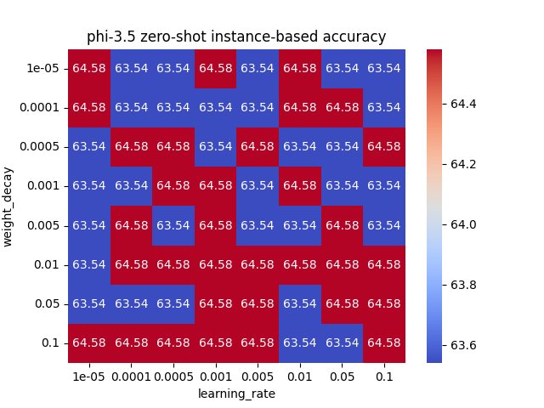

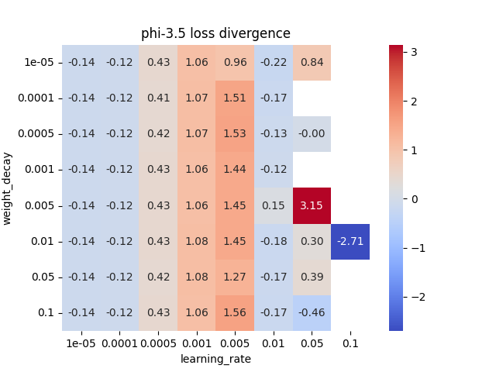
Hyperparameter tuning Results – Phi 3.5 Mini instance-based

Slide 18
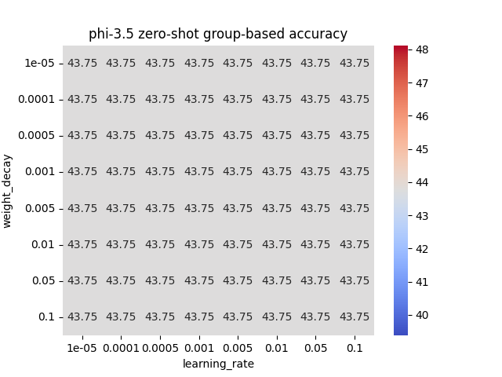

Hyperparameter tuning Results – Phi 3.5 mini group-based

Slide 19
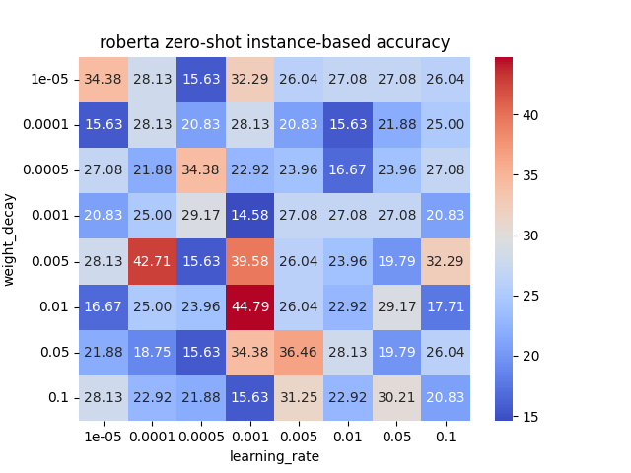
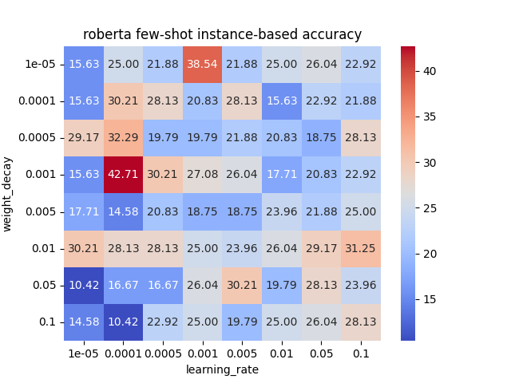
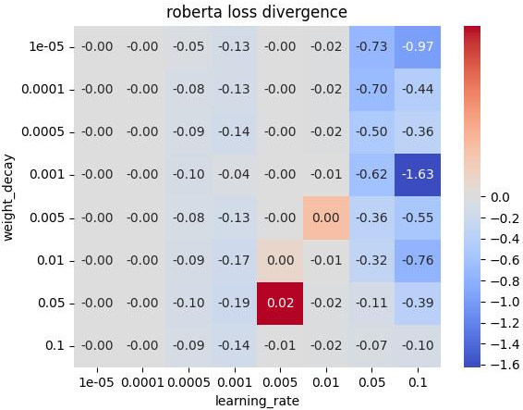
Hyperparameter tuning Results – RoBERTa instance-based

Slide 20
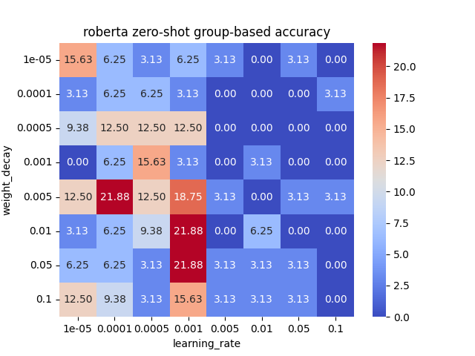
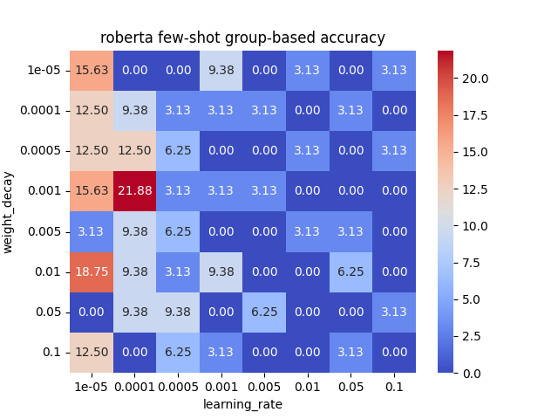
Hyperparameter tuning Results – RoBERTa group-based

Slide 21
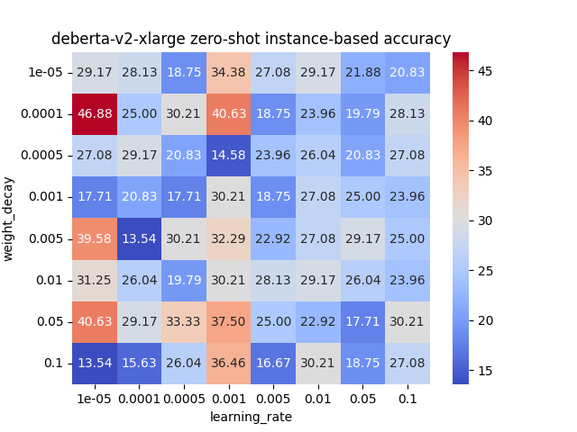
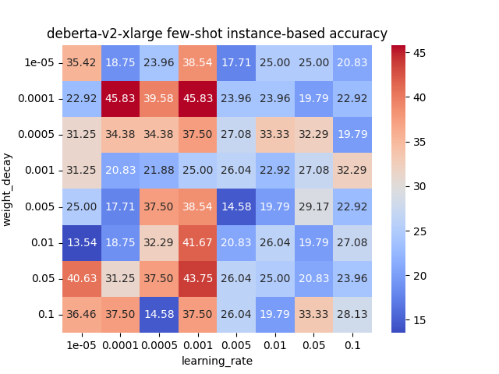
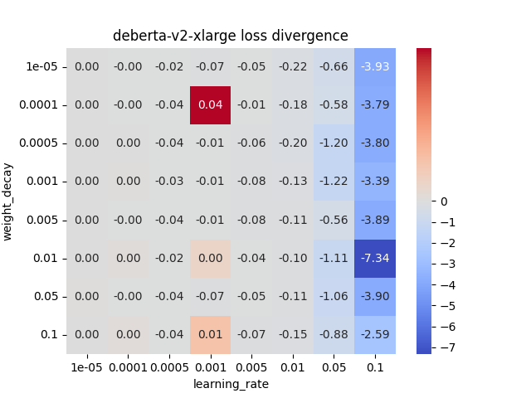
Hyperparameter tuning Results – DeBERTa v2 instance-based

Slide 22
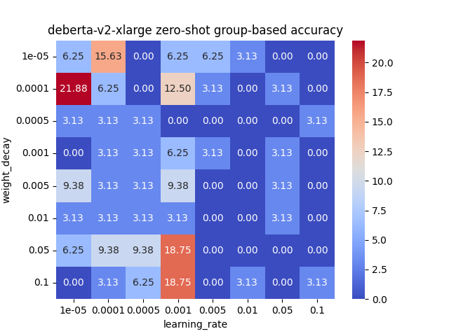
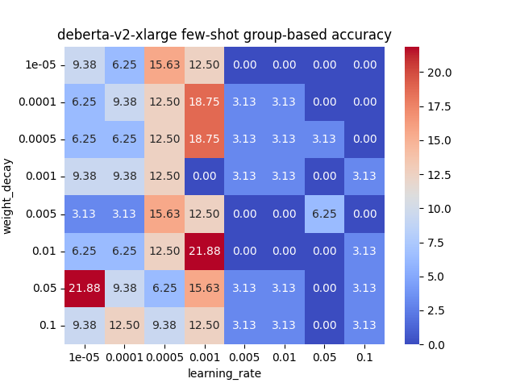
Hyperparameter tuning Results – DeBERTa v2 group-based

Slide 23
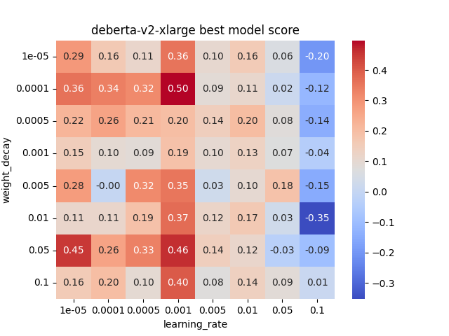
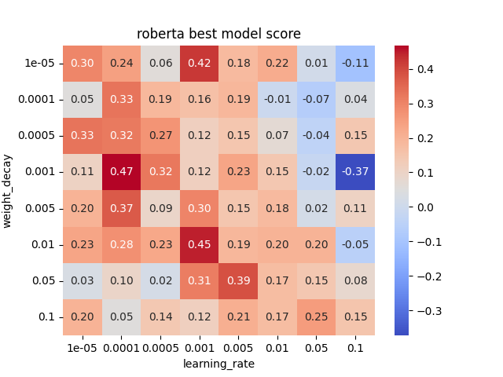
Hyperparameter tuning - Selecting Best model
Calculate the total average accuracy for zero-shot, few-shot for instance-based and group-based accuracy
Normalize the average accuracy using min-max normalization
Calculate the absolute value of loss divergence then normalize using min-max normalization
Calculate the best model score as the difference between normalized total accuracy and normalized absolute loss divergence
Notes:
22-25 hung

Slide 24
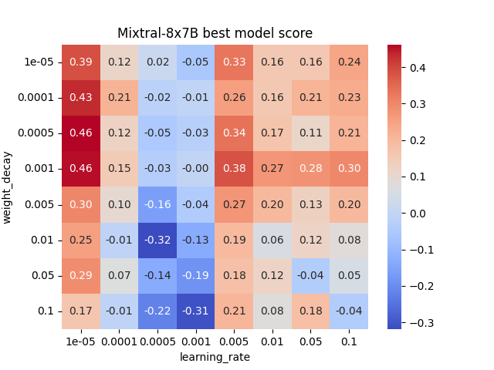
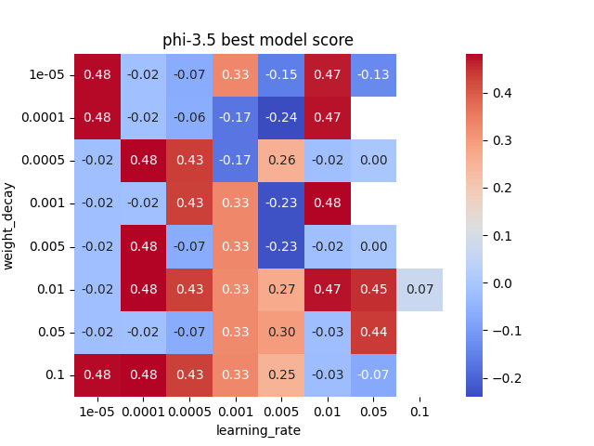
Hyperparameter tuning - Selecting Best model

Slide 25
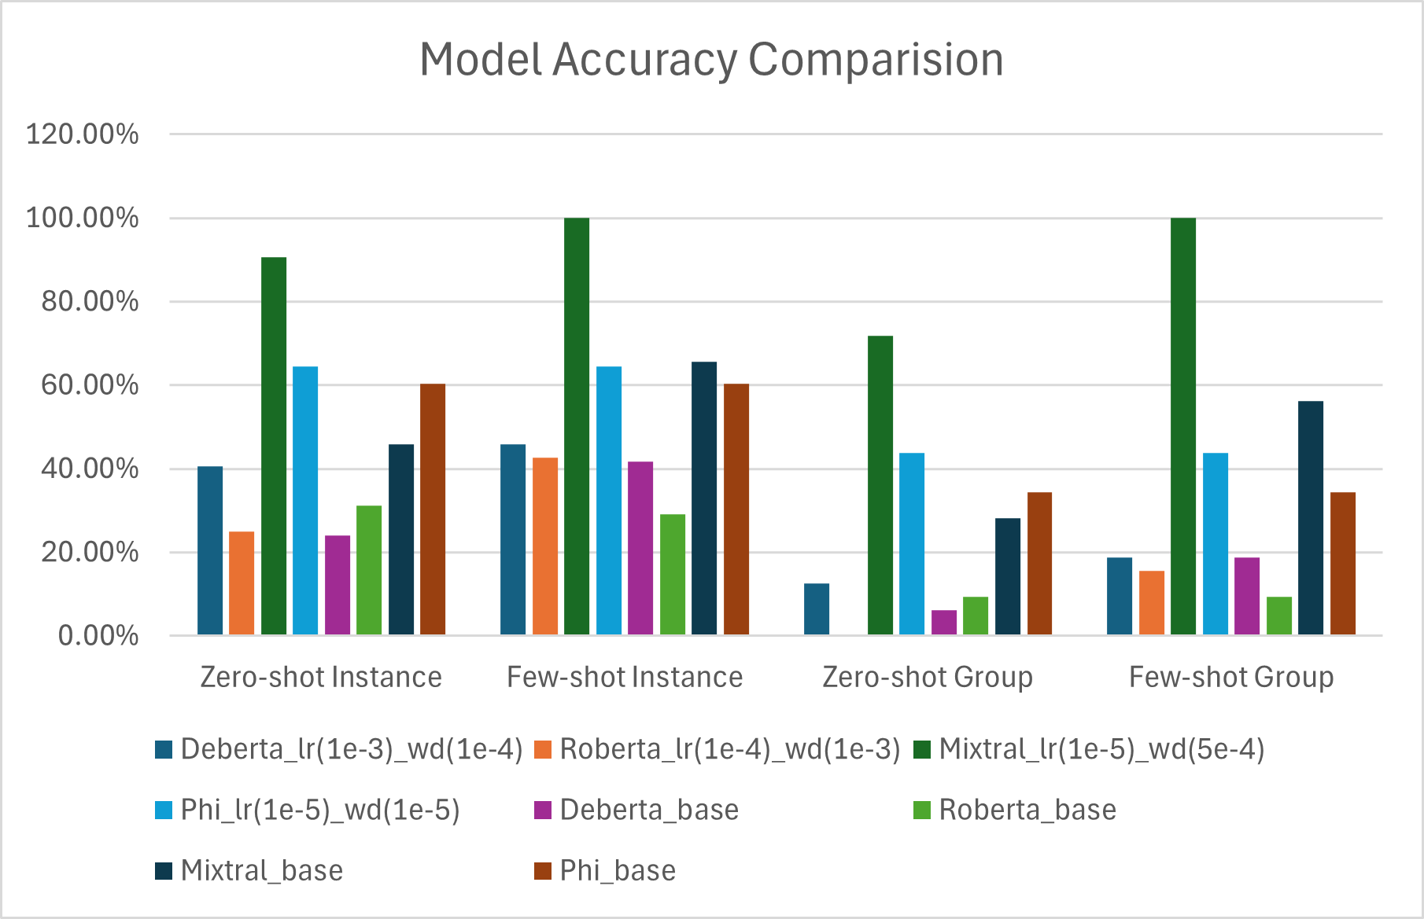
Model accuracy comparison

Slide 26
Lessons learned & Future Improvements
Gradient Instability in Phi Model: Encountered exploding gradients during training, highlighting the need for better stabilization techniques.
Overfitting in Mixtral: Identified sensitivity to certain learning rates,, indicating the need for tuning rate schedules.
BERT models incompatibility: BERT models underperform significantly compared to LLM models
Expand Data and Model Diversity: Incorporate more datasets and models to improve robustness and generalization.

Slide 27
ANY QUESTIONS?

